Slide 1

IITRAA Youth Participation Survey
Insights, Analysis and Recommendations
Prepared by: Nandan Choudhary – Batch 2023
Somansh – Batch 2024
Suyash – Batch 2020
Prempal Singh – Batch 2018
Ranjit Karamchandani – Batch 2002
Kapil Puri – Batch 1993

Slide 2
IITRAA Youth Participation Survey
Objective:
The IITRAA EC (2024-26), observes and collectively has a view that the young Alumni participation in IITRAA affairs is low and lacks enthusiasm. This needs to change and therefore have tasked a team to seek insights on reasons, analyze root cause and put recommendations for IITRAA and its chapters, that can help improve this behavior.
This study aims to provide strategic insights for increasing alumni involvement, particularly among younger graduates, by analyzing participation patterns (in a survey targeted at Alumni graduating in 2010 or any time later (last 15 yrs), their expectations from Association affairs and suggestions to drive up their engagement with this body

Slide 3
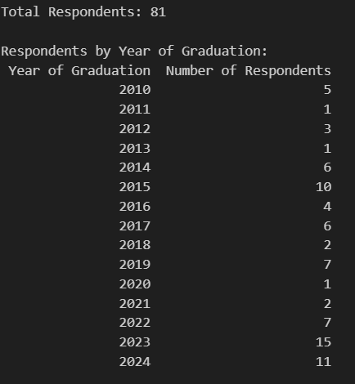
Brief Description of the Data
Data Source: The data analyzed here, has been collected from an online survey conducted among IIT Roorkee alumni who graduated in the year 2010 or later.
Sample Size: The survey received responses from a diverse group of alumni across multiple graduation year groups and geographical locations.
Data Points: The survey includes questions on:
Awareness and membership status
Participation in alumni events and activities
Preferred communication channels
Suggestions for improvement and enhanced engagement

Slide 4
What We Are Trying to Achieve
Primary Goal: To understand the factors influencing alumni participation and identify areas to enhance engagement.
Specific Objectives:
Assess the level of awareness and membership in the alumni association.
Identify reasons for non-membership and barriers to participation.
Understand preferred communication channels and event types.
Gather feedback and suggestions to inform future engagement strategies.
Outcome Expectation: Insights from this survey are intended to guide the alumni association in designing tailored initiatives and communication strategies, ultimately fostering a more active and engaged alumni community.

Slide 5
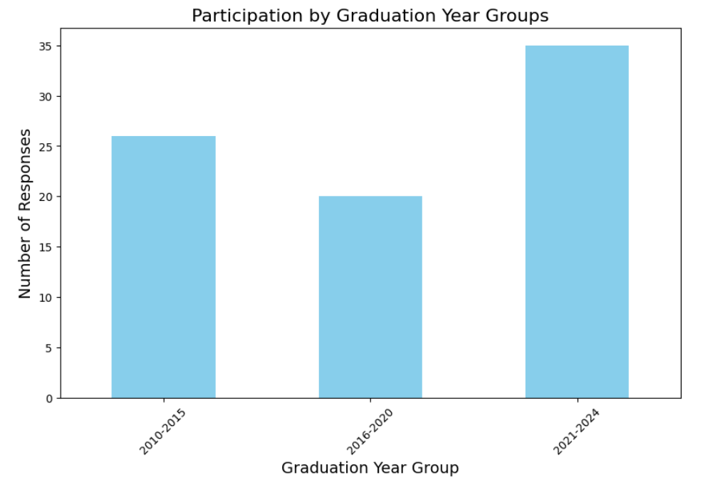
Demographics of participation
We received x responses, from Alumni across the Globe.
The largest participation was from Alumni from recent years(2021-24) – probably a reflection of inquisitiveness and need for this segment ??
Notes:
Description: The bar chart illustrates the participation of IIT Roorkee alumni in alumni events and activities, categorized by graduation year groups from 2010 onwards.
Key Insights:
Alumni who graduated between 2021-2024 show the highest participation, suggesting a stronger connection or recent engagement with the institute.
Participation slightly decreases for the 2016-2020 group, possibly due to career establishment or other transitional phases.
Alumni from the 2010-2015 group demonstrate consistent engagement, indicating a mature but sustained interest in alumni activities.
Implications for Strategy:
The high participation rate among recent graduates (2021-2024) suggests an opportunity to maintain engagement through career-oriented webinars and networking events.
For the 2016-2020 group, targeted communication and events catering to career growth or mentorship might enhance participation.
The 2010-2015 group could benefit from regional meetups and leadership roles in alumni activities to maintain their involvement.

Slide 6
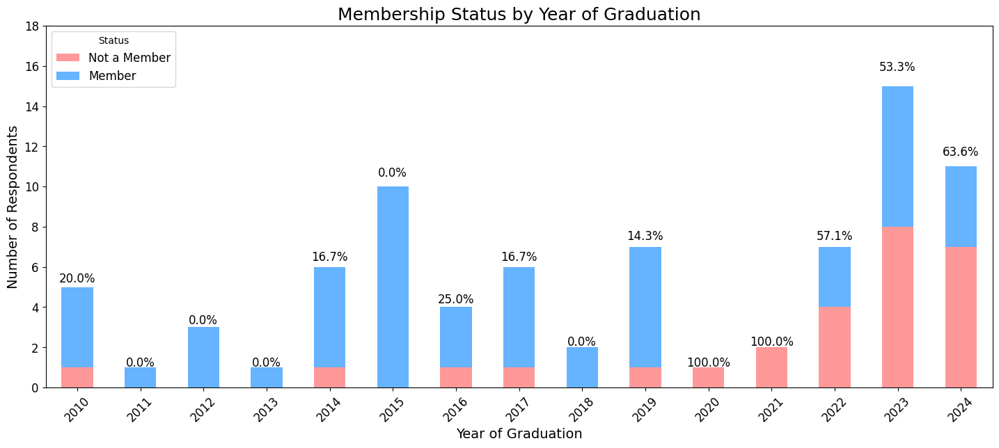
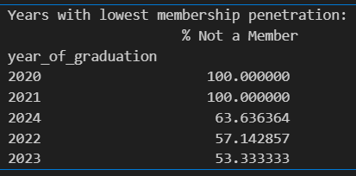
Membership Status
The survey highlighted that the membership penetration was lowest in the Covid year passouts (2020 and 21). Presumably many activities were on hold during this time and also the membership drive
Beyond that the membership drive is lower in recent years (2022-24) but not as low. Heartening signs – however, significant efforts may need ot be done to bring recent graduates in the fold
Notes:
Description: The stacked bar chart displays the membership status of IIT Roorkee alumni, segmented by their graduation year from 2010 onwards. The chart distinguishes between members and non-members to provide a clear view of alumni engagement over the years.
Key Insights:
A noticeable increase in non-membership is observed among recent graduates (2022-2024), indicating a gap in awareness or interest in joining the alumni association.
In contrast, alumni from 2015 and 2019 exhibit a higher proportion of membership, possibly due to active outreach or stronger peer influence during those periods.
Alumni from 2010-2015 consistently show moderate membership rates, suggesting a stable but moderate engagement level.
Implications for Strategy:
Targeted communication and onboarding initiatives are needed for the 2022-2024 graduates to convert non-members into active members.
Leveraging the influence of highly engaged batches (2015 and 2019) can help in advocacy and peer-driven membership campaigns.
Sustaining engagement among the 2010-2015 alumni through leadership roles, mentorship programs, or exclusive events may enhance membership retention.

Slide 7
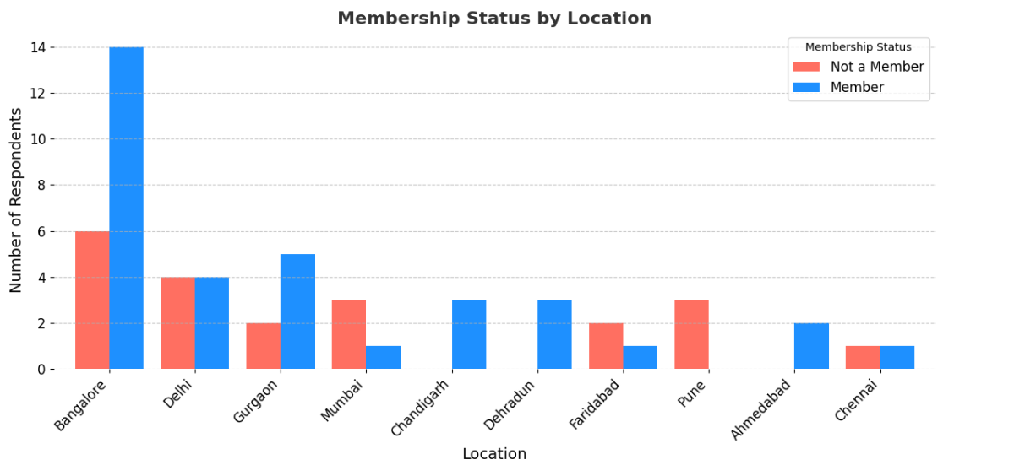
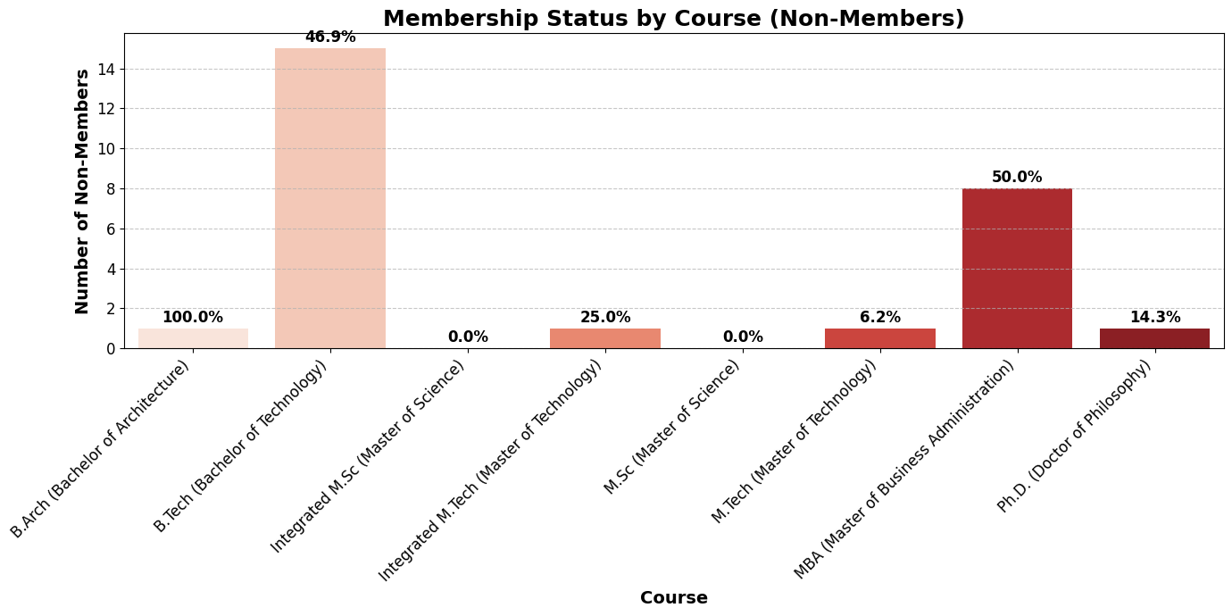
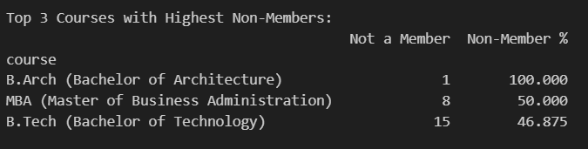
Pockets where we see greater issue of membership
Notes:
Description: The bar chart displays the geographical distribution of IIT Roorkee alumni respondents.
Key Insights:
Bangalore/Karnataka is the most common location, with slight variations in naming (e.g., Bangalore, Bengaluru).
Other significant clusters are in Gurgaon, Mumbai, Delhi, Hyderabad, and Lucknow.
There is redundancy due to inconsistent naming, especially for Bangalore and Gurgaon.
Recommendation:
Standardize location names to get clearer insights.
Focus alumni engagement activities in Bangalore, as it has the highest concentration.
4o

Slide 8
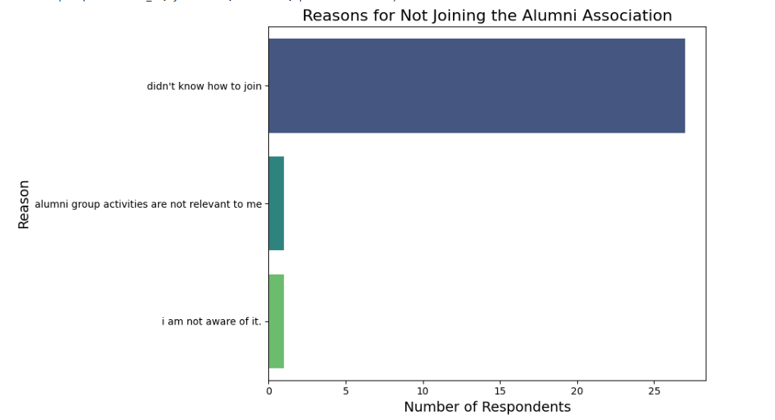
What is inhibiting Alumni from being a member?
Awareness around the process to join, or whom and where to reach out, is probably the most highlighted reason for those not a member still
Notes:
Description: This bar chart illustrates the primary reasons cited by IIT Roorkee alumni for not joining the Alumni Association. The data provides insights into the awareness and perceived relevance of the association's activities.
Key Insights:
The majority of non-members (25 respondents) indicated that they "Didn't know how to join," highlighting a significant gap in communication and onboarding processes.
A smaller proportion mentioned reasons such as "I am not aware of it" and "Alumni group activities are not relevant to me," suggesting a need for better outreach and tailored engagement strategies.
Implications for Strategy:
Enhancing visibility and clarity of the membership process, such as through detailed guidelines on joining, could significantly improve membership rates.
Conducting awareness campaigns and highlighting the value of alumni engagement, especially through relevant activities, can address misconceptions about relevance.
Utilizing digital communication channels to disseminate this information effectively, particularly targeting recent graduates, may increase engagement and participation.

Slide 9
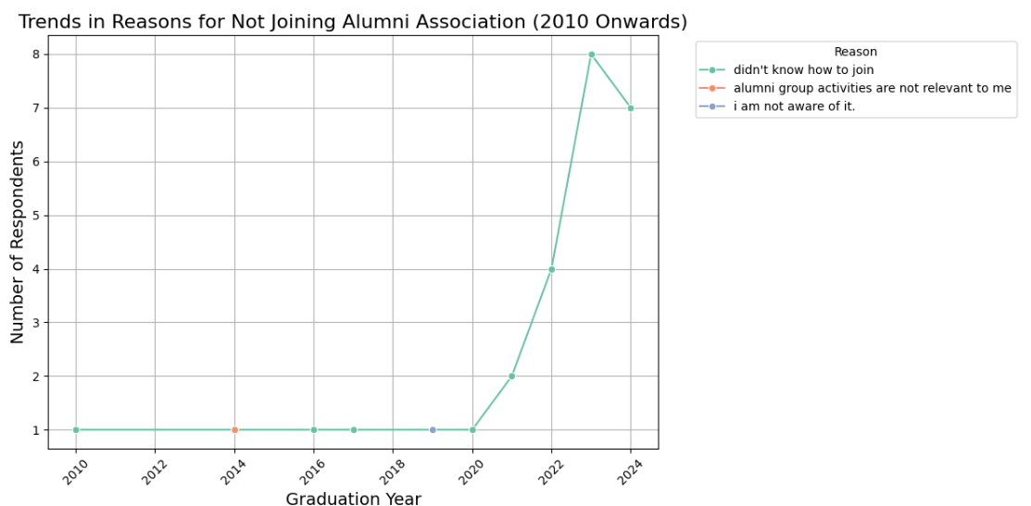
What is inhibiting Alumni from being a member? where is the problem more acute
Year 2020 and later, seem to be most unaware of the process.

Slide 10
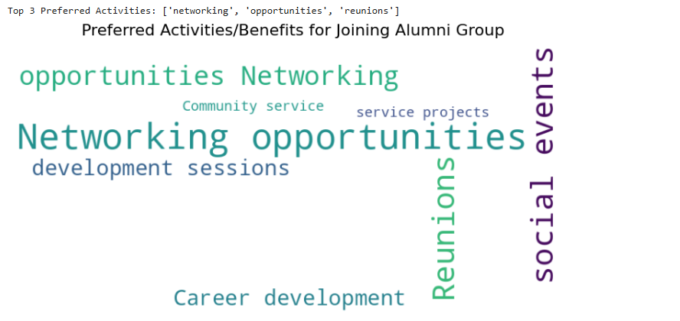
What do young Alumni expect from IITRAA activities/events?
Top three preferred activities/benefits that young Alumni seek from IITRAA activities:
Networking opportunities with other Alumni
Opportunities for themselves – could be career, partnerships or support to sustain their efforts
Reunions – look at these events to catch up with their batchmates etc
Notes:
Description: This word cloud represents the activities and benefits most desired by IIT Roorkee alumni when considering participation in the Alumni Association. The size of each word corresponds to its frequency or importance as mentioned by respondents.
Key Insights:
The most prominent interest is in "Networking opportunities," suggesting that alumni are keen on leveraging connections for professional growth and collaboration.
"Reunions" and "Social events" also feature prominently, indicating a desire for community bonding and nostalgic engagements.
Other notable interests include "Career development," "Development sessions," and involvement in "Service projects" and "Community service," reflecting a blend of professional growth and social impact motivations.
Implications for Strategy:
Organizing networking events with industry leaders and peers can greatly enhance alumni engagement.
Planning reunions and social events with a mix of nostalgic and fun elements can strengthen community bonds.
Introducing career development programs, such as mentorship and skill-building workshops, can provide substantial value to members.
Incorporating community service projects can cater to alumni interested in social responsibility and giving back.

Slide 11
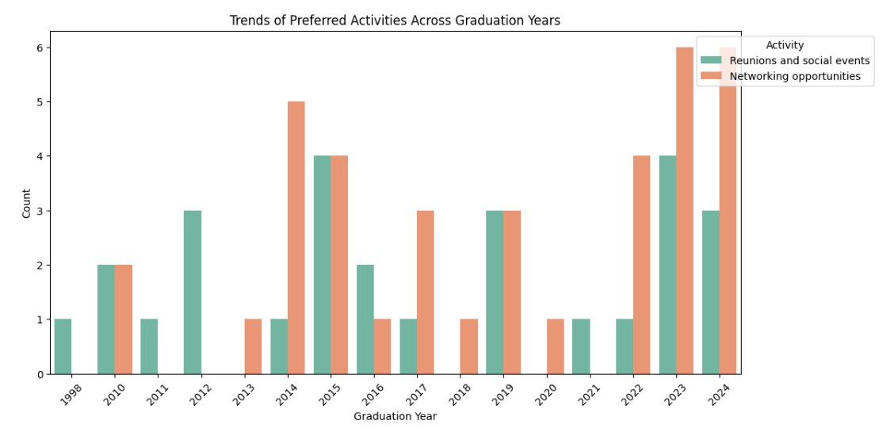
What do young Alumni expect from IITRAA activities/events? – where do we focus for what?

Slide 12
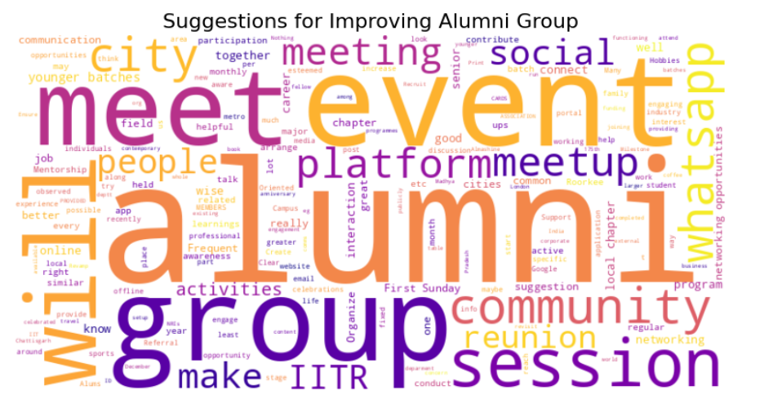
Suggestions from Young Alumni
Top 3 Suggestions:
More Meetups & Events
Frequent city-wise and batch-wise alumni meetings.
Organizing social events, reunions, and interactive sessions.
Both online and offline meetups should be encouraged.
Better Communication & Engagement Platforms
Strong emphasis on WhatsApp groups, community platforms, and apps.
Creating a centralized communication channel to keep alumni informed.
Ensuring regular updates about alumni activities.
Career Support & Mentorship
Job referrals, mentorship programs, and industry interactions.
Career-oriented sessions, networking opportunities, and professional meetups.
Engaging younger batches through structured career guidance.

Slide 13
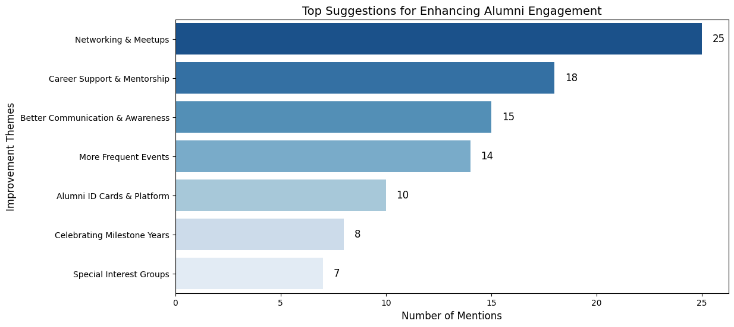
Notes:
Membership Status by Location
Description: This bar chart shows the membership status of IIT Roorkee alumni based on their current location. The data reveals variations in membership across different cities, particularly in and around Bangalore.
Key Insights:
There is inconsistent representation due to variations in city naming (e.g., Bangalore, Bangalore - Karnataka - India, Bengaluru, Bangluru). Consolidating these would provide clearer insights.
Bangalore (including all its variants) shows a mix of members and non-members, indicating a large alumni base with untapped potential for engagement.
Locations like Ahmedabad and Aligarh show a smaller but fully engaged alumni population.
Recommendation:
Data Cleaning: Standardize city names to get a more accurate count of members vs. non-members. For example, merge all variations of Bangalore into one category.
Targeted Outreach: Bangalore, having the largest group of alumni, could benefit from more local events or meetups to convert non-members into active members.
Localized Engagement: Tailor engagement strategies for smaller but fully engaged locations like Ahmedabad and Aligarh to maintain and strengthen existing connections.

Slide 14
Conclusion and recommendations
Recommendations for IITRAA Central body
Create greater awareness on IITRAA and its chapters, especially amongst recent graduates/passouts. To enable this, tap early:
Reach out to IITR students while in college and tell them about IITRAA/Alumni network and significance. Share process to join and conduct drives to onboard.
Do a face to face session with students – In Main Campus and Noida Campus each, once a year.
Conduct 1-2 online sessions largely for this audience, delivered by IITR Alumni
Build content on Linkedin/Instagram and other channels at regular intervals and tag IITR handles and networks, especially addressing this segment.
Create clear steps laying down process to join and share at frequent intervals, on all channels. Once in every Qtr.
Need to create a central Database to enable Alumni community to find, access and network better. Strengthen IITRA Almashine portal by driving focus efforts to onboard and enrichen correct Alumni data – especially Location, Current organization and email/contact, other interest etc
Enrichen the Newsletter covering larger footprint of content from younger passouts (2010 to 2024). 40% content reserved for this segment
Sensitization about talking about UOR and IITR and take pride in both constructs.
Work with DORA to restart the onboarding process for batces passing out.
Increase visibility of Alumni network/IITRAA during key events in Campus. Participate and sponsor booth/magazines. Include IITRAA Alumni content in student publications.
Conduct an Annual event where invitations are sent to Alumni across the Globe/students. 175 yr celebration was a grand idea highlighted by many- Endeavor to sustain and expand this format.
Organize a career event once a yr at Main and Noida Campus each.
Provide a place to publish Calendar of events across all Chapters.
Offer benefits to Alumni through the portal – eg one of the IITs has partnered with MMMT to offer extra baggage allowance for Alumni booking through portal. IITRAA Lko chapter has enabled discount for OPD through a partnership with a Major Hospital chain. Such benefits to be extended across.

Slide 15
Conclusion and recommendations
Recommendations for IITRAA Chapters
Drive efforts to onboard chapter Alumni on Central DB with their location updated. This will allow them to enable greater networking between Alumni in their chapter and a platform to communicate better mutually.
Conduct atleast 2 face to face events in a year and 2 online.
If possible spread these every 3 months. For online events, Chapter could also take advantage of online organized by other Chapters, provided they actively promote it as if their own event.
Anchor atleast one event around a major festival to drive participation of families of Alumni.
For atleast one of the events in a yr, the ticket size for participation should be restricted to around Rs 1000-1500, so that cost is not an inhibitor.
Encourage Alumni to provide contribution to Alumni portal /regular newsletter.
Facilitate help to youngster at the time of joining the chapter and enable them make connections for their need.
Make an attempt to include in event some format/content around suggested options like Standup/Impromptu/Comedy/Dance. Young sports events like Sports/trek/Marathon are good options that will help entice young population. Leverage neighborhood chapter events like Marathon/Sports and extend to your chapters to drive greater participation.
Post an event, facilitate networking of attendees by sharing details around participants of the event. This may include ways to reach them, their interest and location etc.

Slide 16
Thank you

Slide 17
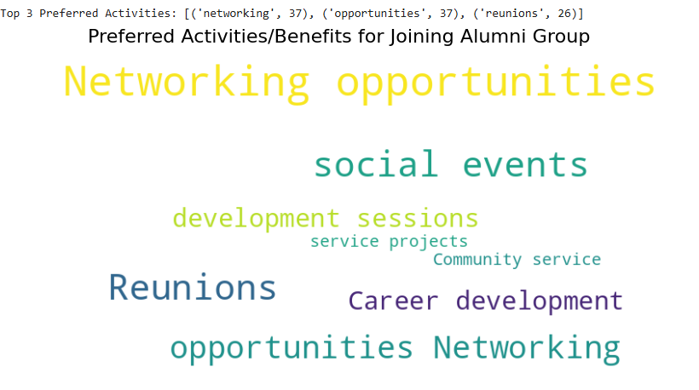
Notes:
Description: This word cloud represents the activities and benefits most desired by IIT Roorkee alumni when considering participation in the Alumni Association. The size of each word corresponds to its frequency or importance as mentioned by respondents.
Key Insights:
The most prominent interest is in "Networking opportunities," suggesting that alumni are keen on leveraging connections for professional growth and collaboration.
"Reunions" and "Social events" also feature prominently, indicating a desire for community bonding and nostalgic engagements.
Other notable interests include "Career development," "Development sessions," and involvement in "Service projects" and "Community service," reflecting a blend of professional growth and social impact motivations.
Implications for Strategy:
Organizing networking events with industry leaders and peers can greatly enhance alumni engagement.
Planning reunions and social events with a mix of nostalgic and fun elements can strengthen community bonds.
Introducing career development programs, such as mentorship and skill-building workshops, can provide substantial value to members.
Incorporating community service projects can cater to alumni interested in social responsibility and giving back.

Slide 18
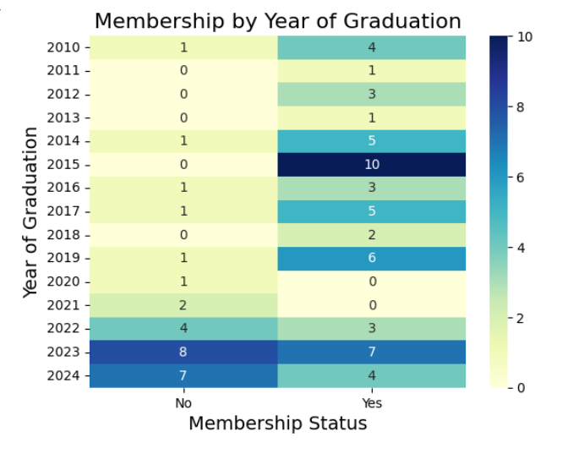
How to Interpret the Heatmap:
X-Axis (Membership Status)
"No" → Respondents who are not members.
"Yes" → Respondents who are members.
Y-Axis (Year of Graduation)
Lists different graduation years of respondents.
More recent years (2022-2024) are at the bottom, and older years (1998, 2010, etc.) are at the top.
Cell Values (Numbers in the Grid)
Each cell shows the count of respondents in that specific graduation year who either are or are not members.
Example:
In 2015, 10 respondents are members, while 0 are not.
In 2023, 8 are not members, while 7 are members.
Notes:
Membership by Year of Graduation
Description: This heatmap shows the membership status of IIT Roorkee alumni based on their year of graduation, highlighting the number of members and non-members for each year.
Key Insights:
Alumni from 2015 show the highest membership, indicating strong engagement from this batch.
Recent graduates from 2023 and 2024 have more non-members compared to members, suggesting a gap in engagement with newer batches.
Alumni from 2010 to 2014 show lower participation overall, possibly due to a lack of sustained connection over the years.
Recommendation:
Enhance outreach and engagement strategies for recent graduates (2023 and 2024) to convert non-members into active members.
Reconnect with alumni from 2010 to 2014 through targeted initiatives like mentorship programs, webinars, or reunion events.
Leverage the high engagement of the 2015 batch by involving them as ambassadors or mentors for other groups.

Slide 19
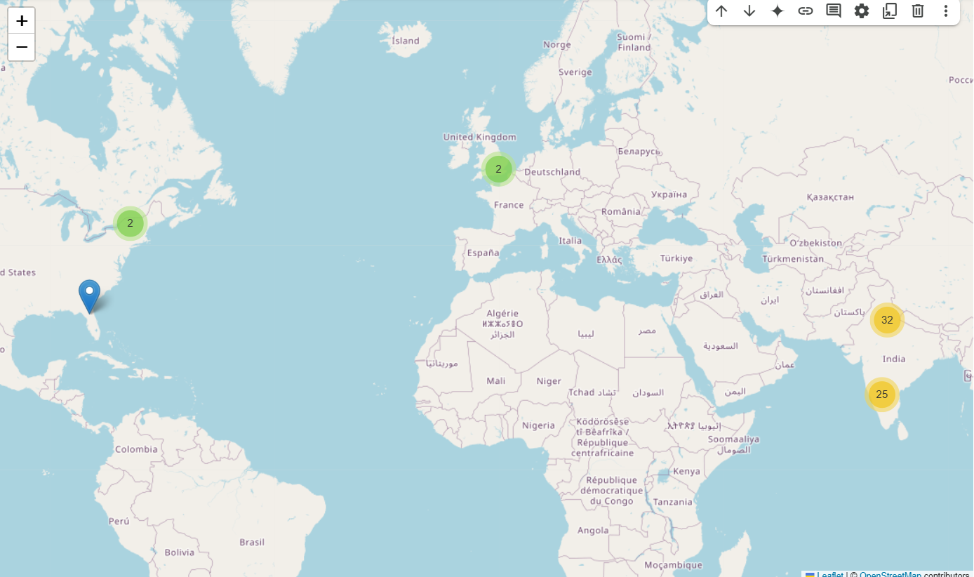
Notes:
Global Distribution of Respondents
Description: The map illustrates the geographical spread of IIT Roorkee alumni respondents worldwide.
Key Insights:
India has the highest concentration, with two clusters in the northern and southern regions (32 and 25 respondents, respectively).
In North America, respondents are mainly in Canada and the USA.
Europe shows a smaller cluster, primarily in France and nearby countries.
Recommendation:
Focus alumni networking and events in India, particularly in the high-density regions.
Explore virtual engagement opportunities for international respondents.

Slide 20
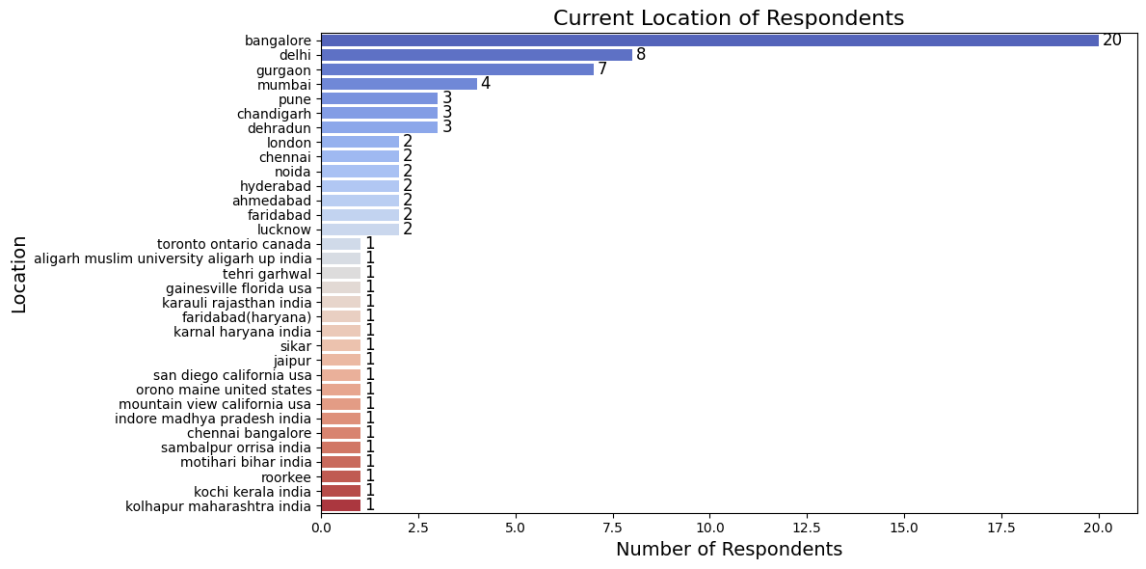
Bangalore appears at multiple places. We should clean up the data and update some fields to make this more coherent.
Notes:
Description: The bar chart displays the geographical distribution of IIT Roorkee alumni respondents.
Key Insights:
Bangalore/Karnataka is the most common location, with slight variations in naming (e.g., Bangalore, Bengaluru).
Other significant clusters are in Gurgaon, Mumbai, Delhi, Hyderabad, and Lucknow.
There is redundancy due to inconsistent naming, especially for Bangalore and Gurgaon.
Recommendation:
Standardize location names to get clearer insights.
Focus alumni engagement activities in Bangalore, as it has the highest concentration.
4o

Slide 21
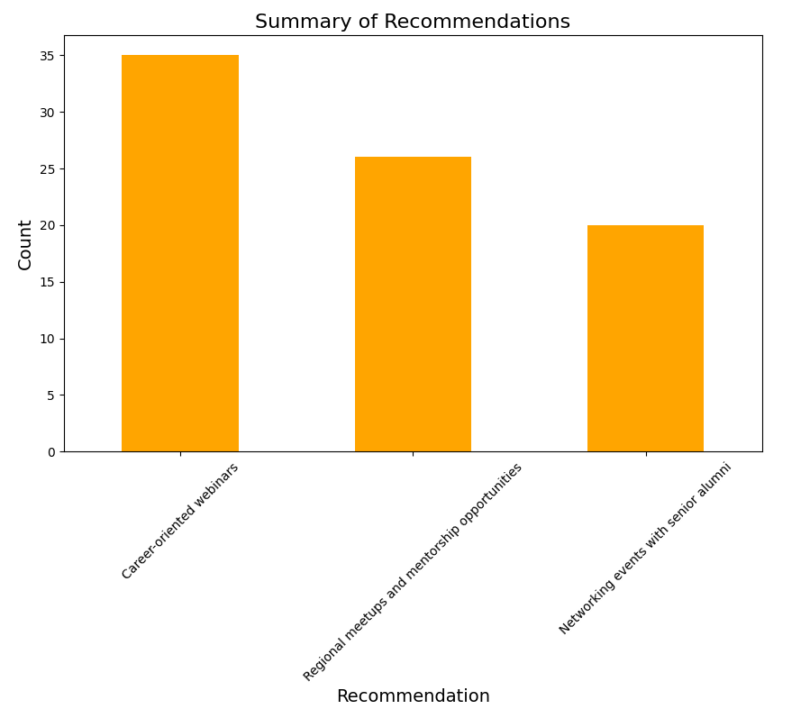
Notes:
Summary of Recommendations
Description: This bar chart illustrates the preferred types of alumni engagement initiatives, as recommended by the respondents. It provides insights into what activities could potentially enhance membership and involvement in the IIT Roorkee Alumni Association.
Key Insights:
Career-oriented webinars are the most favored, indicating a strong demand for professional development and learning opportunities.
Regional meetups and mentorship opportunities are also highly recommended, suggesting the importance of networking and guidance, especially for younger alumni.
Networking events with senior alumni received relatively fewer votes but still represent a significant interest area, highlighting the value of connecting with experienced professionals.
Recommendation:
Prioritize Career-oriented Webinars: Organize regular webinars focusing on industry trends, skill development, and career growth. Collaborating with alumni experts could enhance the value of these sessions.
Facilitate Mentorship Programs: Establish structured mentorship opportunities by pairing senior alumni with recent graduates or early-career professionals. Regional meetups can complement this by fostering local connections.
Leverage Senior Alumni Network: While networking events received the fewest votes, they are still crucial for building a robust alumni network. Hosting exclusive sessions with senior alumni as guest speakers or panelists can attract diverse participants.
4o

Slide 22


